Slide 1
GENDER AND AGE PREDICTION USING DEEP LEARNING
Presented by
IHJAS MUHAMMED PGDA Batch 27

Slide 2
PROBLEM STATEMENT
As we know, as every person has different facial features. Humans can recognize easily but for computers it is comparatively a difficult task so here we have used neural network approach where the machine will learn on itself by gaining experiences and the accuracy will increase based upon experience it gains.
Gender and Age Prediction system is working of a machine to train itself so that it can analyze and predict the gender and age of the given images.
The goal of our work is to create a model that will be able to analyze and classify the individuals in the images as male or female and predict their age.
We apply the Gender and Age Prediction System on UTK Face Dataset.
Here we use Both Classification(Gender Classification) and Regression(Age Prediction).

Slide 3
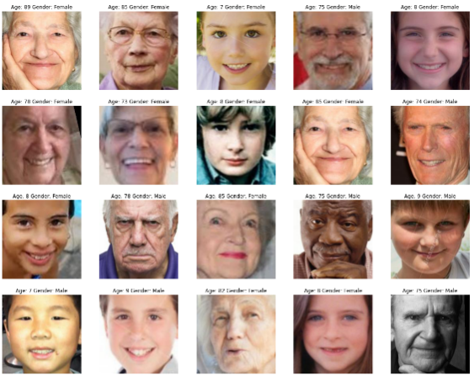
DATASET
UTK Face dataset is a large-scale face dataset with long age span (range from 0 to 116 years old).
The dataset consists of over 20,000 face images with annotations of age, gender, and ethnicity.
The images cover large variation in pose, facial expression, illumination, occlusion, resolution, etc.
Images are labelled by age, gender, and ethnicity
The objective of the project is to detect gender and age using facial images. Convolutional Neural Network is used to classify the images. There are 2 output types namely, gender(M or F) and age.
A sample of dataset is given aside.

Slide 4
OUTLINE
CONVOLUTIONAL NEURAL NETWORK
STRUCTURE OF CONVOLUTION NEURAL NETWORK
METHODOLOGY
TRAINING OF MODEL.
RESULT
CONCLUSION

Slide 5
CONVOLUTIONAL NEURAL NETWORK
Convolution neural network is a deep learning method which is broadly used for image classification, image recognition ,object detection etc.,
In this project, we will see how CNN's can be used for image classification and regression. For this, the model takes an image as input ,processes it and classifies it under a certain category. An image is collection of pixels, with features which specifies the height, width and the dimensions of the image.
For example- image with 6x6x3 dimensions signifies that it is an rgb (red, green, blue) color image while an image with dimensions 6x6x1 signifies a grayscale images.

Slide 6
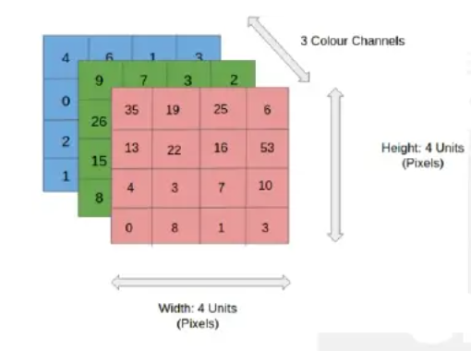
CONVOLUTIONAL NEURAL NETWORK
In the figure, we have 4x4x3 RGB image which has been separated by its three color panels- RED,GREEN and BLUE. The height and width of image is 4. In grayscale image ,the color channels will be reduced to 1.
There are a number of such color spaces for images such as Greyscale, RGB, HSV , CMYK etc.,
In the CNN model , the training and testing of the input image is performed by passing the image through a series of convolution layers with filters. These filters are also known as kernels.
This is followed by the pooling layers for feature extraction ,the dense layers and finally ‘SoftMax’ function is used for classifying the object within a probabilistic range of values of 0 to 1.

Slide 7
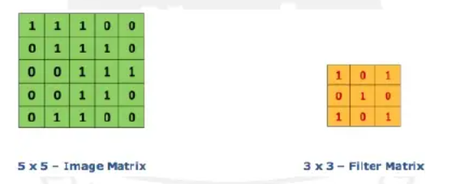
CONVOLUTIONAL NEURAL NETWORK
CONVOLUTION LAYER
The convolution layer is first layer of CNN model architecture which starts to extract features from the input. The convolution layer operates with two inputs, One is the image matrix while the other being the filter or kernel.
The convolution layer safeguards the relationship between the original image pixels by learning the features of the image using small square patches.
In the figure, we have an image matrix of size 5x5 and a kernel size of 3x3.The image values are 0 and 1. Therefore to obtain a ‘Feature map’ we multiply the image matrix with the filter.

Slide 8
CONVOLUTIONAL NEURAL NETWORK
POOLING LAYER
Pooling layer is another extremely significant feature of convolution neural networks. Pooling layer will resolve to reducing the number of parameters when the image are large.
Pooling is also known as subsampling or down sampling which helps us to reduce the dimensionality of each feature map by leaving out trivial traits and retaining all the important information.
FULLY CONNECTED LAYER
Every CNN architecture is provided with a fully connected layer of neurons at the end.
As in CNN, neurons in a fully connected layer have fill connections to all activations in the previous layer and work similarly.
After training , the feature vector from fully connected layer is used to classify images into distinct categories.
Every activation unit in the next layer is coupled to all inputs from this layer.

Slide 9
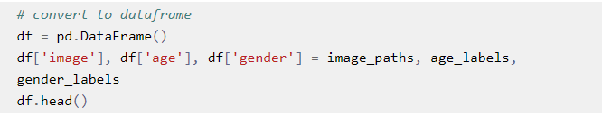
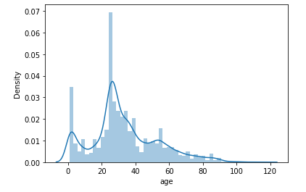
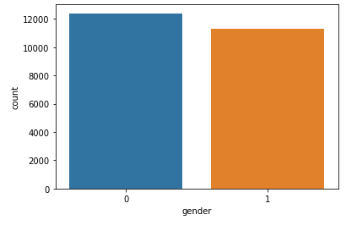
METHODOLOGY
Import Modules and Load the Dataset:
At first we load the necessary modules that we require to build the model.
We then load the dataset for processing.
Now we create the data frame.
We then map the gender label for a better display in the graphs.
Exploratory Data Analysis:
We perform the necessary analysis on the data to get meaningful insights.

Slide 10
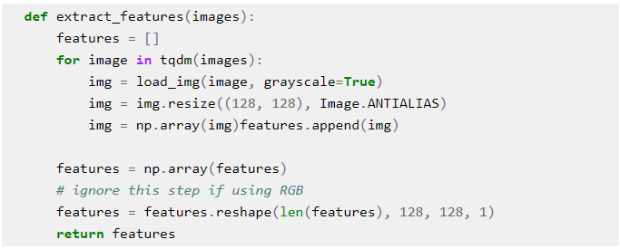


METHODOLOGY
FEATURE EXTRACTION:
We define the feature extraction function.
Image reshaped is defined and in grayscale
For quicker processing.
Let us then test the feature extraction.
MODEL CREATION:
Now we proceed to the model creation and we plot the model.
WE THEN TRAIN THE MODEL

Slide 11
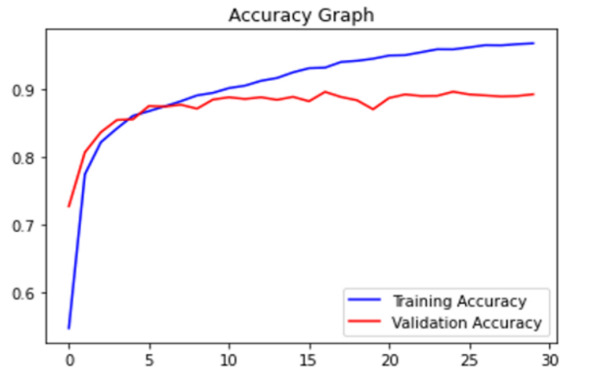
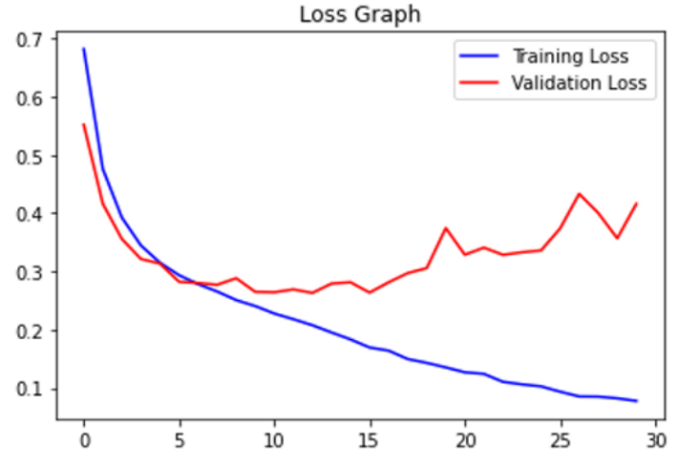
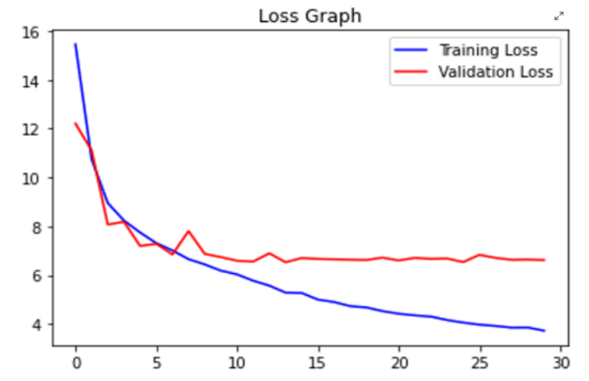
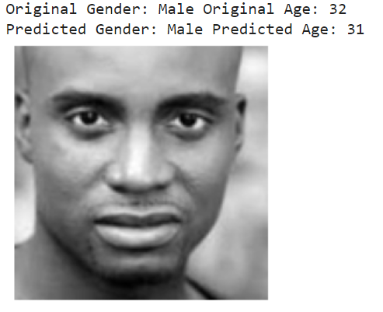
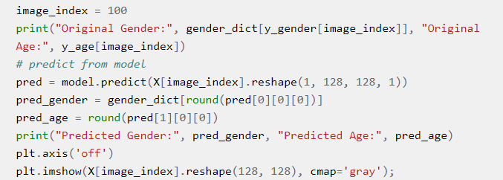
Results and predication
PLOT THE RESULTS
We plot the results for gender and age
PREDICTION WITH TEST DATA

Slide 12
Conclusion and future scope
In this project, we have explored the Gender and Age Prediction image classification using UTK Face dataset. This is a deep learning project to learn image classification and regression using feature extraction techniques and visualize the results through different plots.
Training the model by increasing the no. of epochs can give better and more accurate results.
The no. of layers of the model can be increased to process large dataset.

Slide 13
THANK YOU
PERSONAL INFO Name: Ihjas Muhammed Mobile: 9496526314 Email: ihasmhd@gmail.com

